Slide 1
Status of Arkansas’ Abandoned Pesticide Program
Jason Robertson
Assistant Director Pesticide Division
Arkansas State Plant Board
TPSA Conference Mobile, AL.
February 5-7, 2013

Slide 2
Program Overview
We began collecting funding in 2001 after passage of Arkansas Act 1130 of 2001.
Collections started in 2005 to allow funding to build up.
Act 1130 also established an advisory board consisting of representatives from ASPB, Cooperative Extension, Arkansas Department of Environmental Quality, NRCS, and Farm Bureau.

Slide 3
Program Overview
Funding is provided through an extra registration fee ($50/product) added to all agricultural pesticides registered in Arkansas.
The program is intended for collection of agricultural pesticides only.
Collection Events are held twice per year (Usually in March and October).

Slide 4
Program Overview
The process allows the producers to remain anonymous.
Farm Bureau’s participation is very important in helping the producers stay anonymous.
Disposal is free for those who wish to participate.

Slide 5
Program Details
We meet with representatives from each county in Arkansas. This includes the County Judge, Cooperative Extension and Farm Bureau. Other interested parties are encouraged to attend these meetings as well. This may include OEM, Fire Departments, Environmental Coordinators, and city planners.
The county representatives select a location and date that works best for their community.

Slide 6
Program Details
County officials are provided a press release, radio spot, safety tips, inventory forms, large posters, a mail out flyer and letter to the farmers. These items are essential for promotion of the program.
We ask local Cooperative Extension agents and Farm Bureau agents to promote the program in their county. The regulated community usually has a better working relationship with these entities than they do with ASPB.

Slide 7
Program Details
A second meeting is conducted in each county to introduce the hazardous waste contractor and to view inventory forms. This helps in planning for large collections and on-site pick ups when needed.
Our current hazardous waste contractor is PSC.
Contracts can be very difficult to get through state government because of the “unknowns”. Our last renewal took almost 18 months from start to finish!

Slide 14
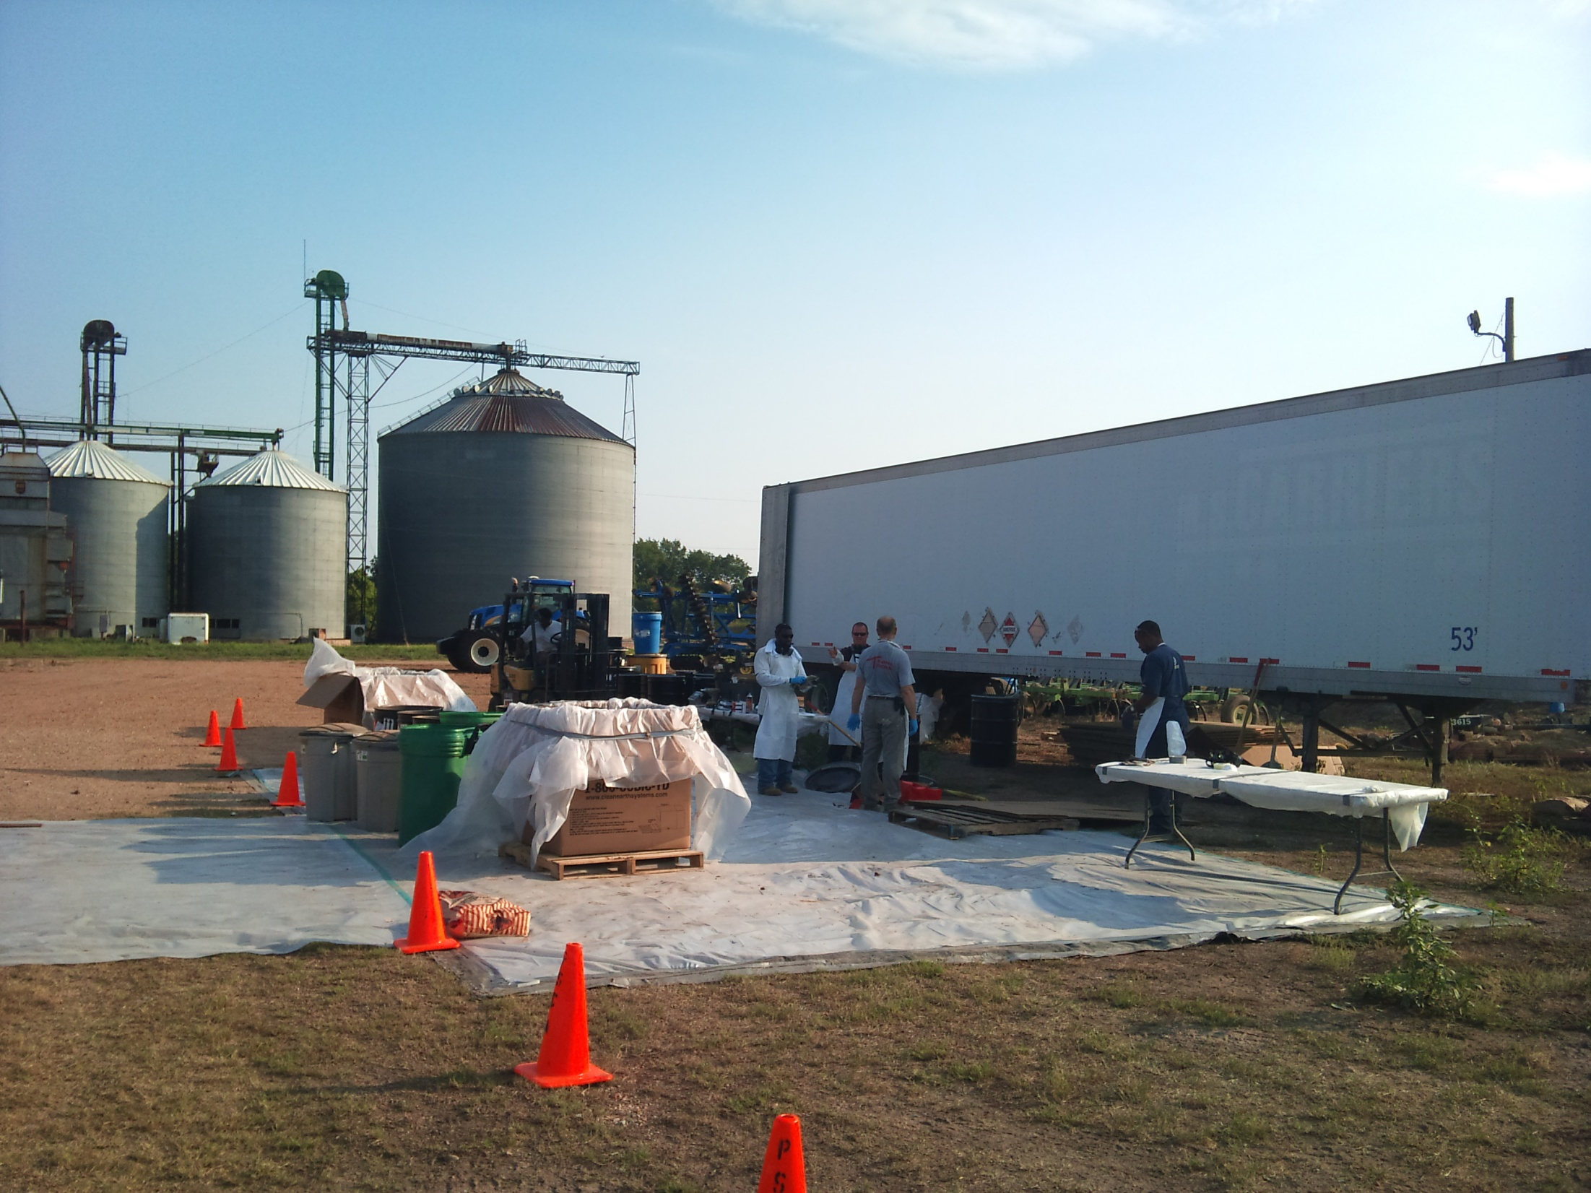

Slide 15
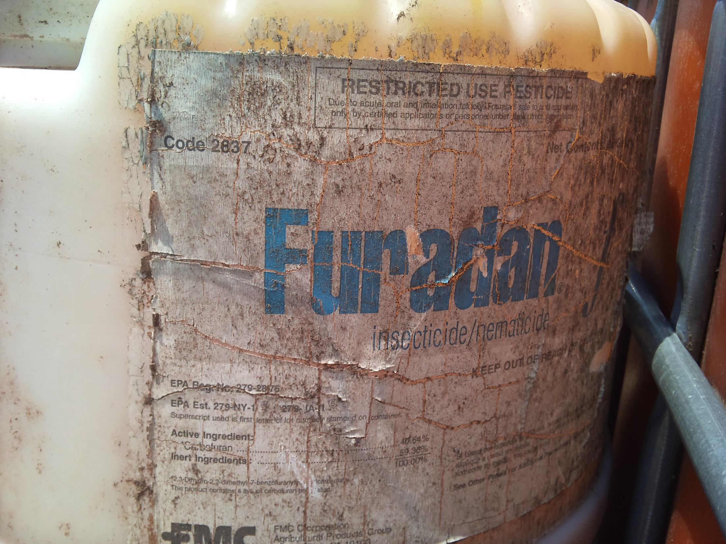

Slide 16
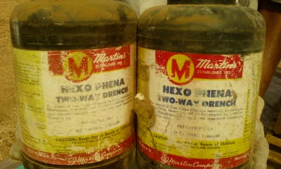

Slide 17
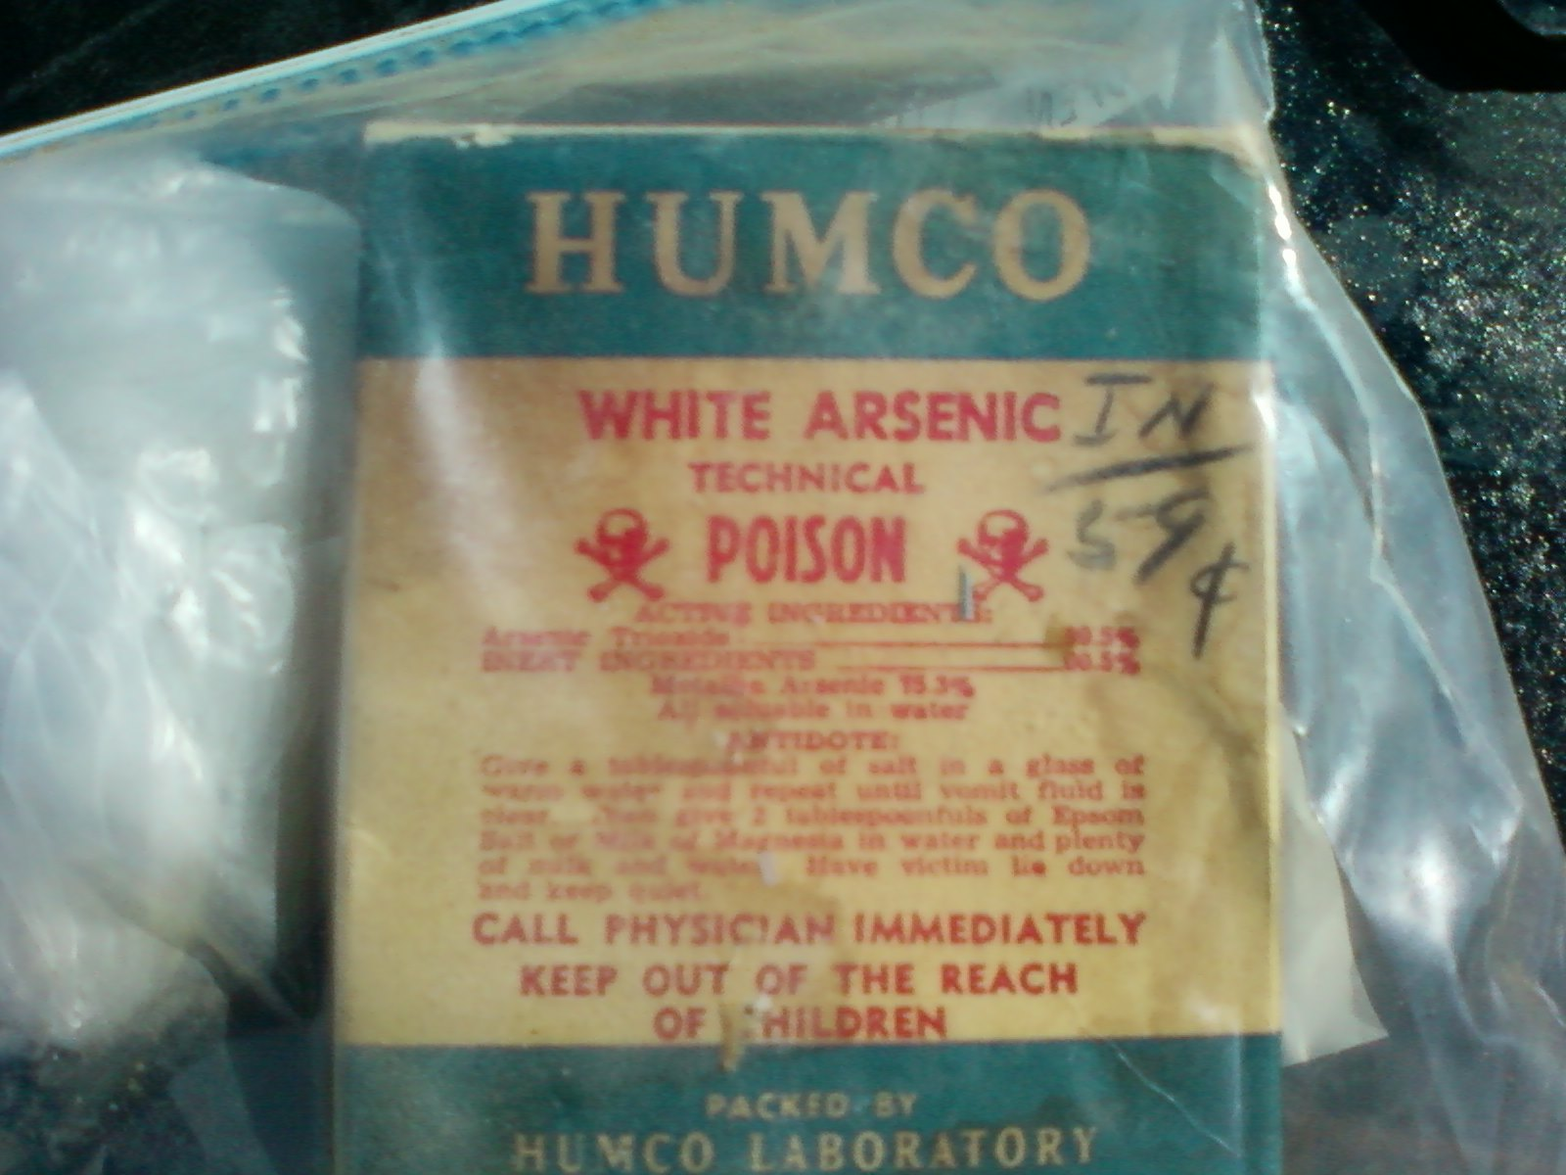

Slide 18
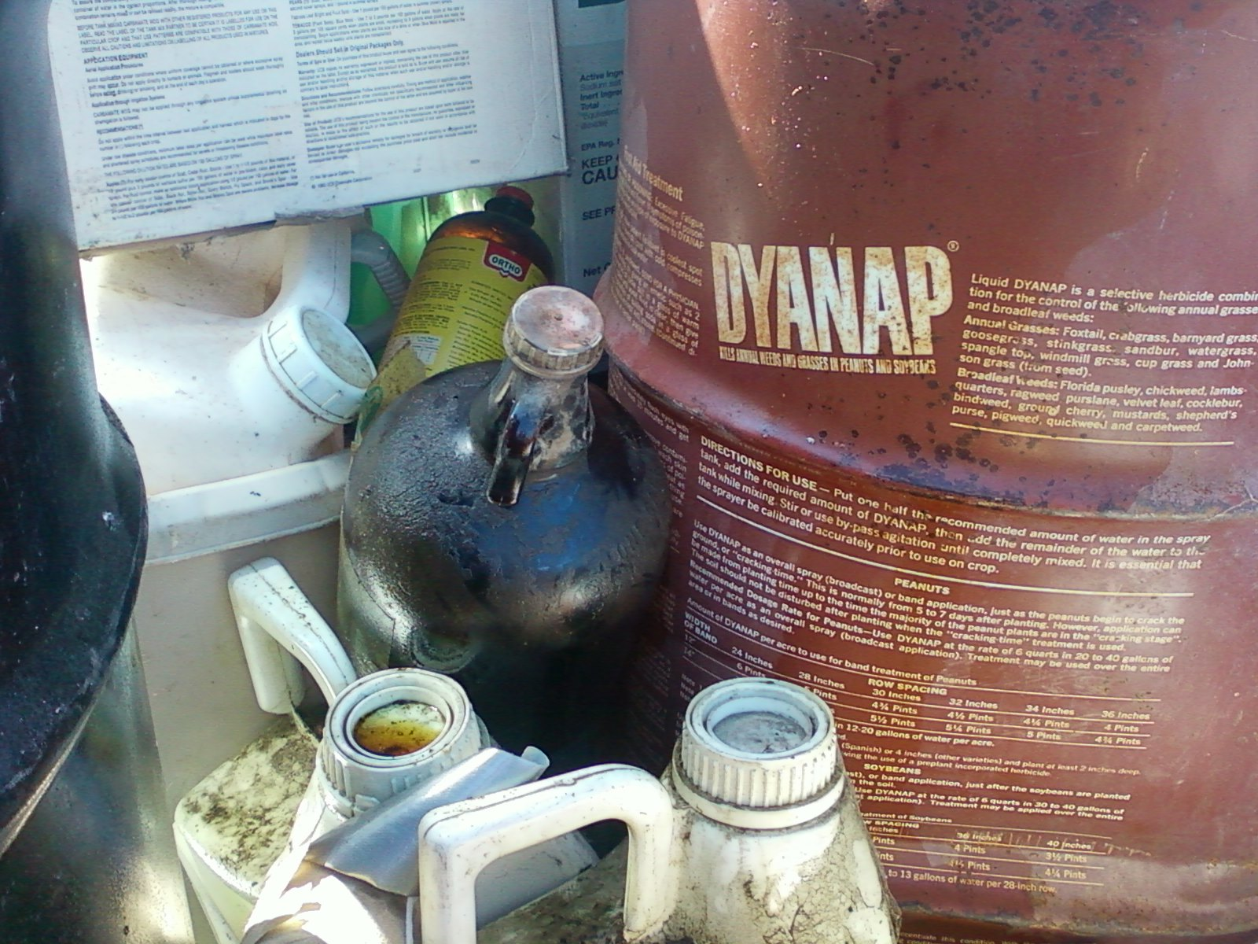

Slide 19
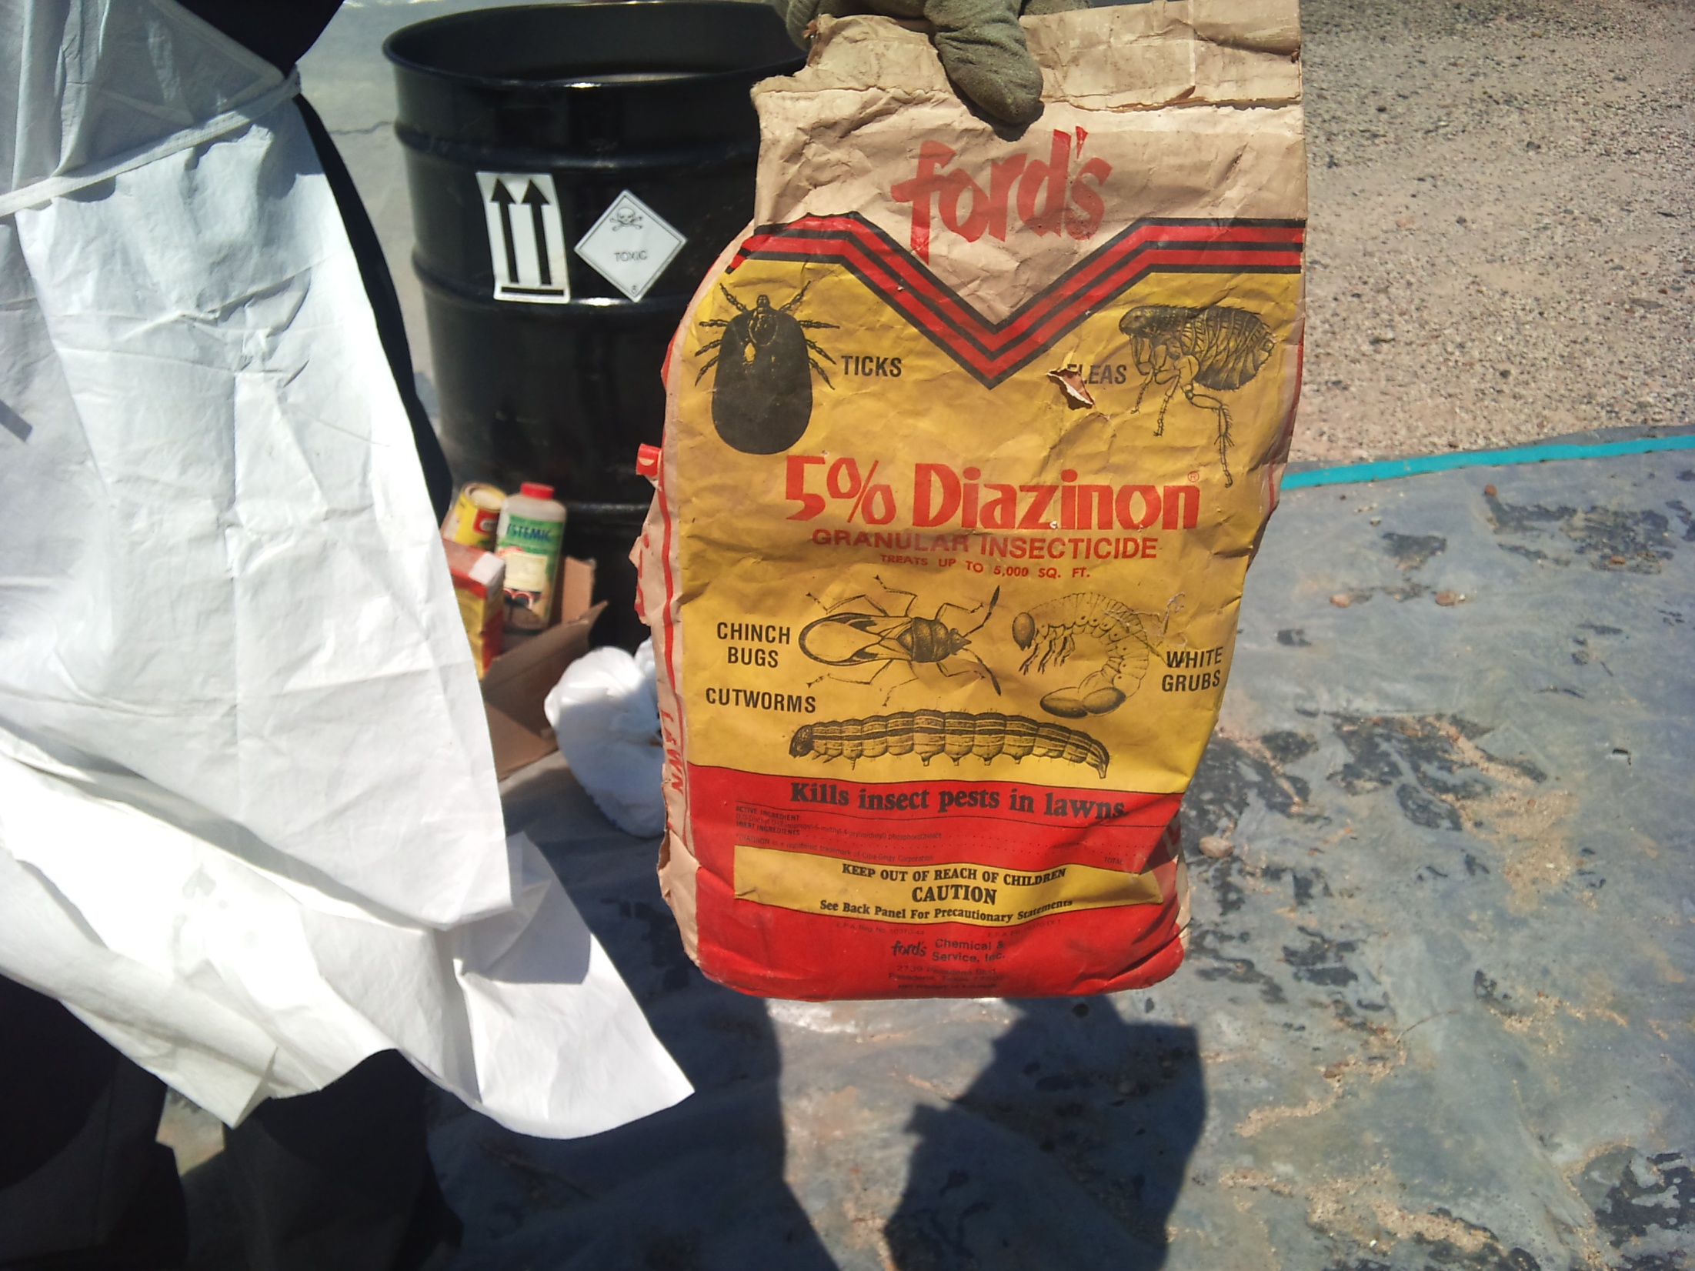

Slide 20
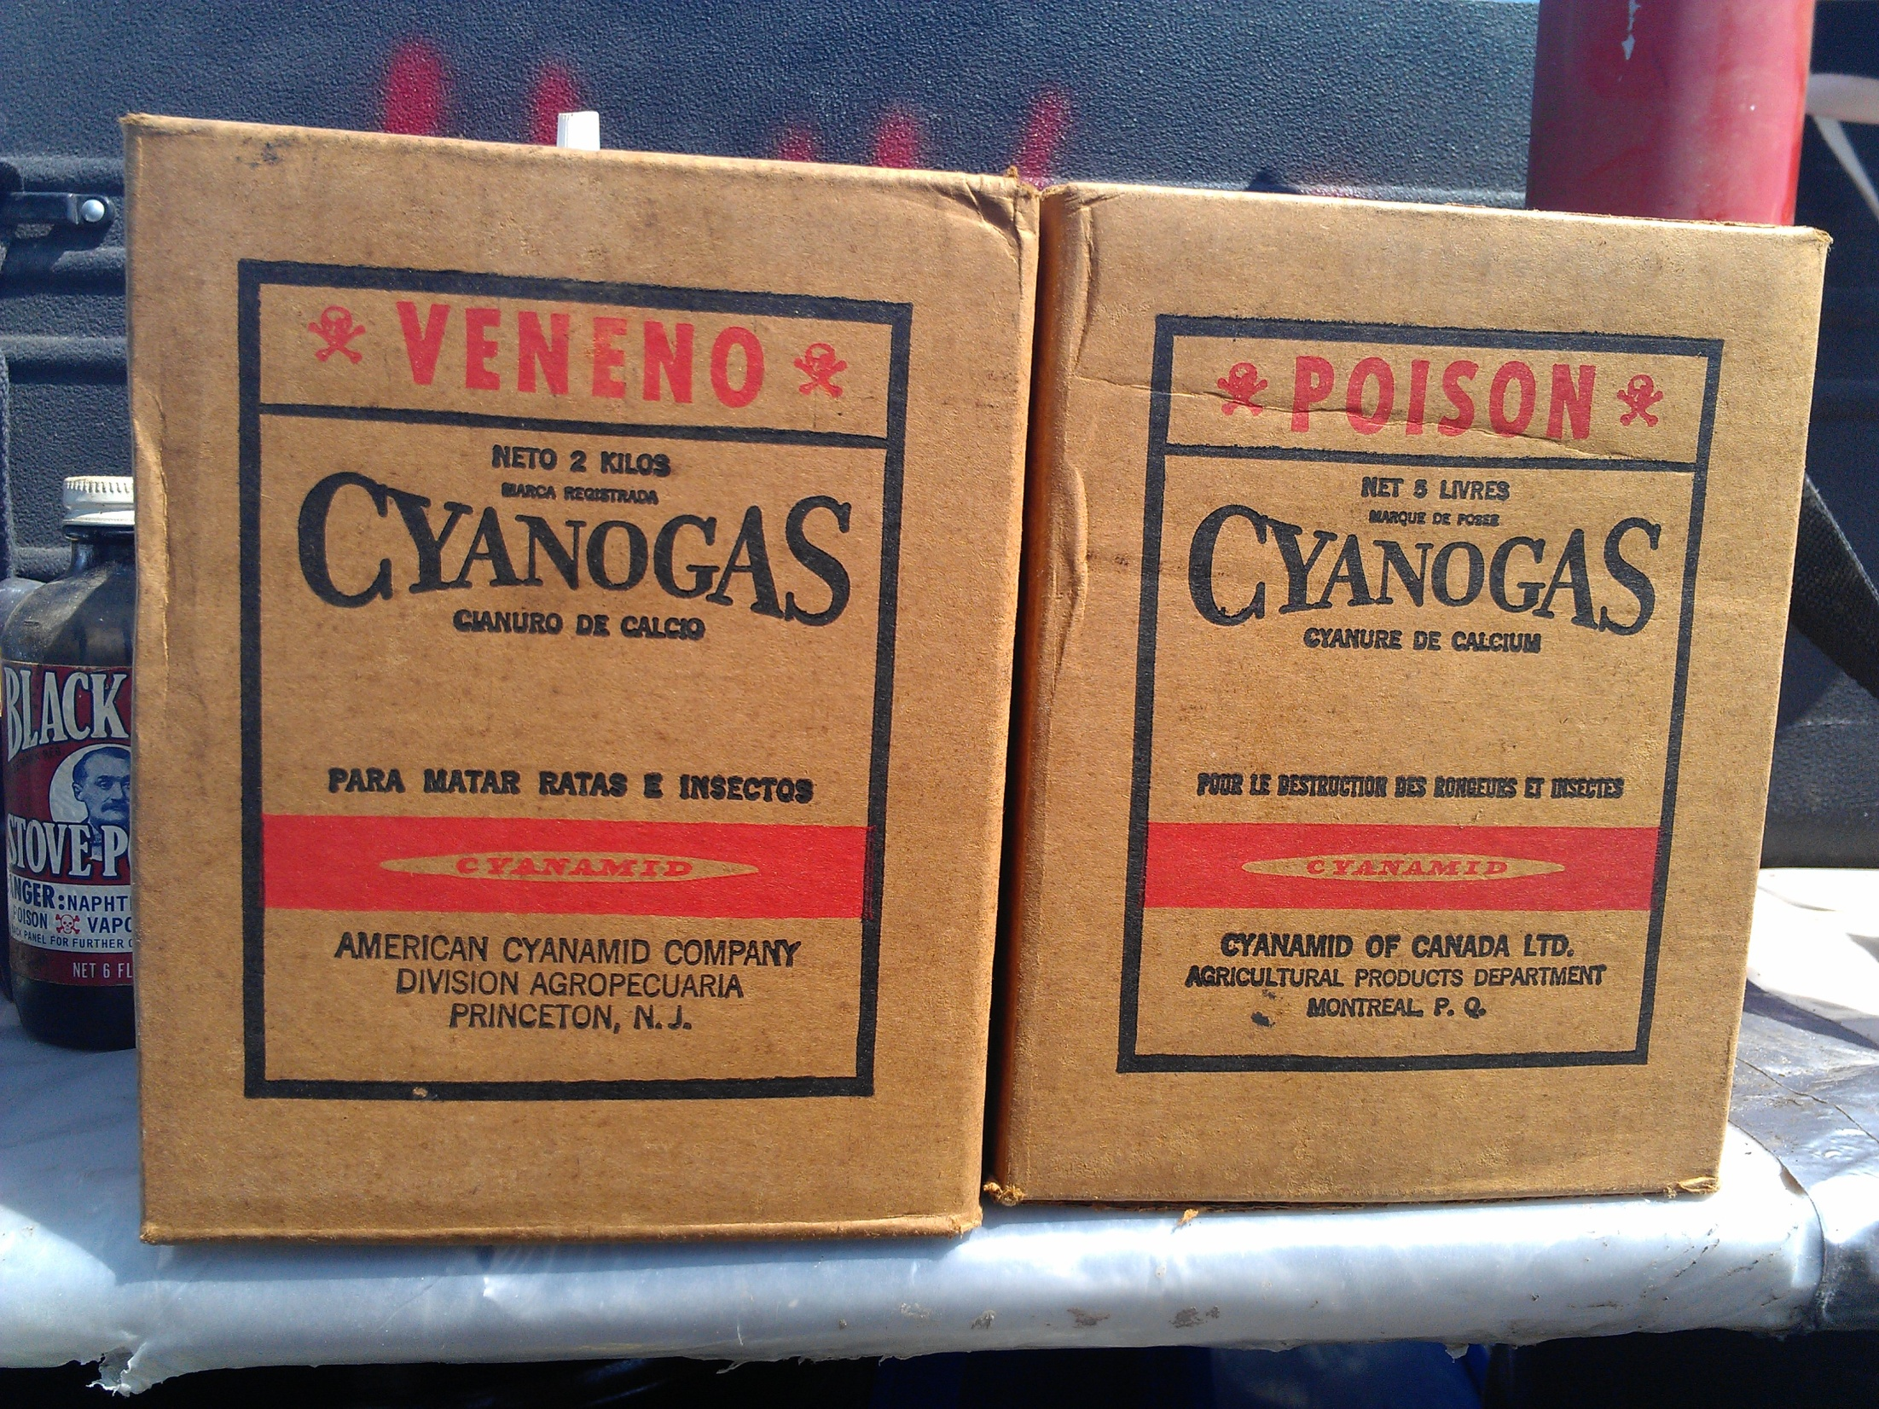

Slide 21
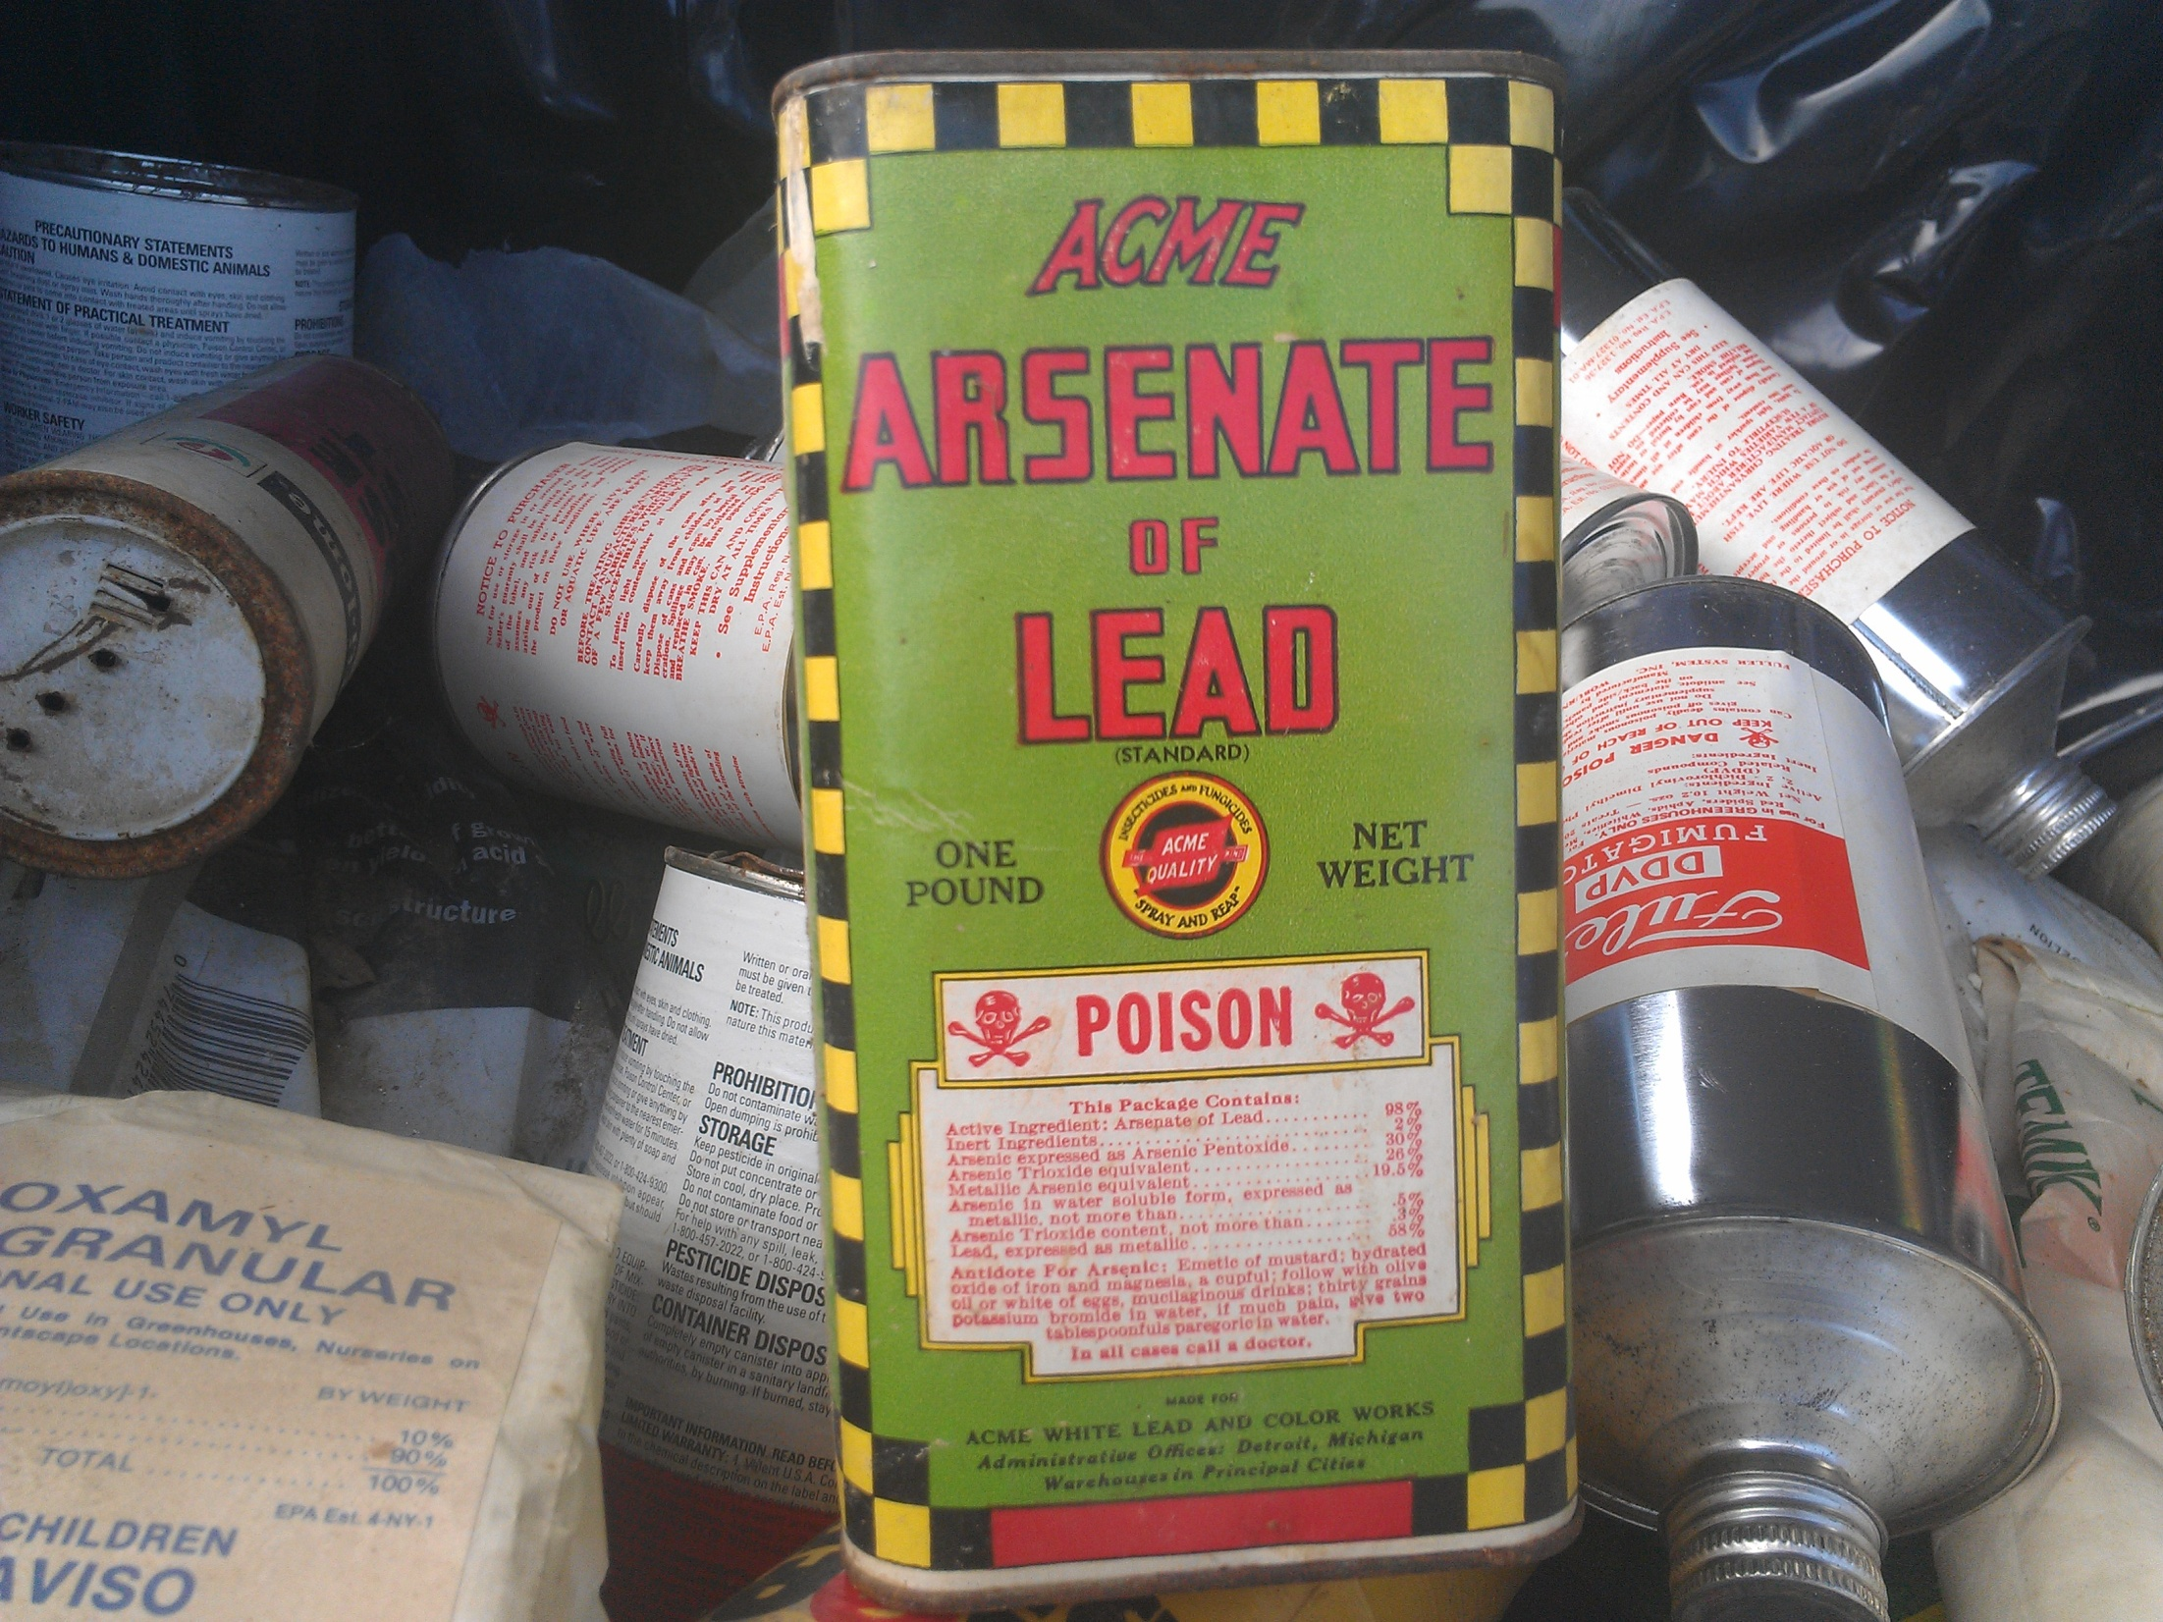

Slide 22
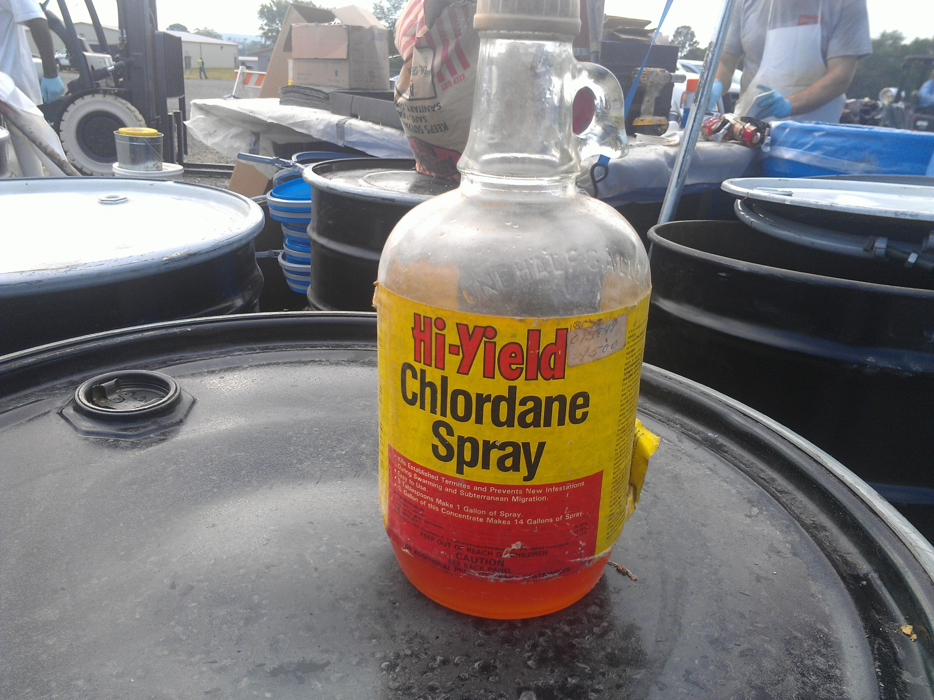

Slide 23
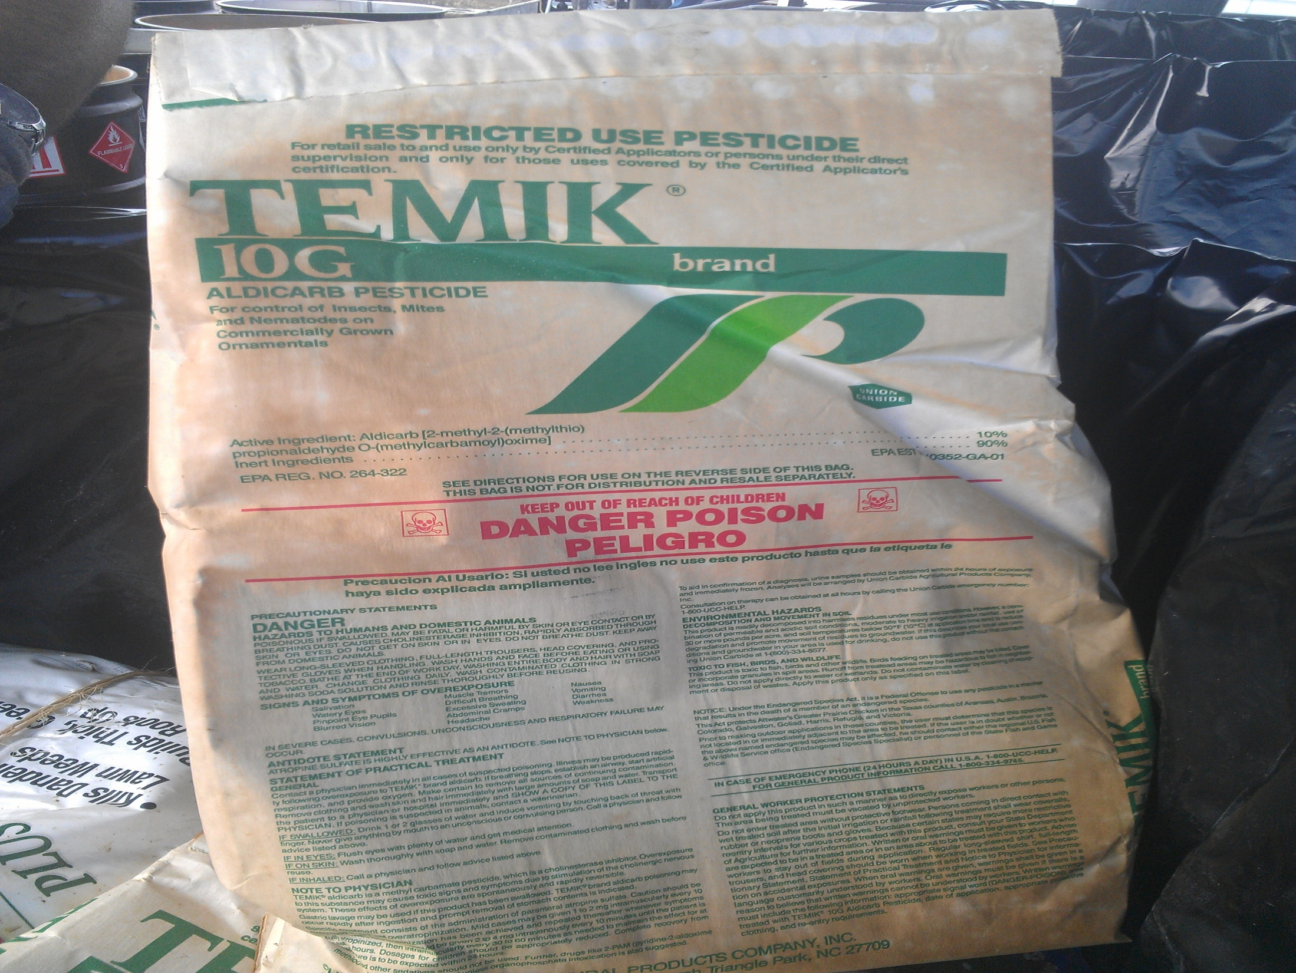

Slide 24
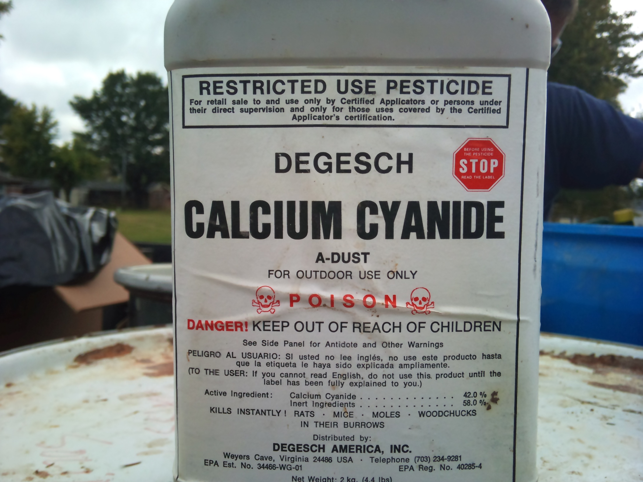

Slide 25
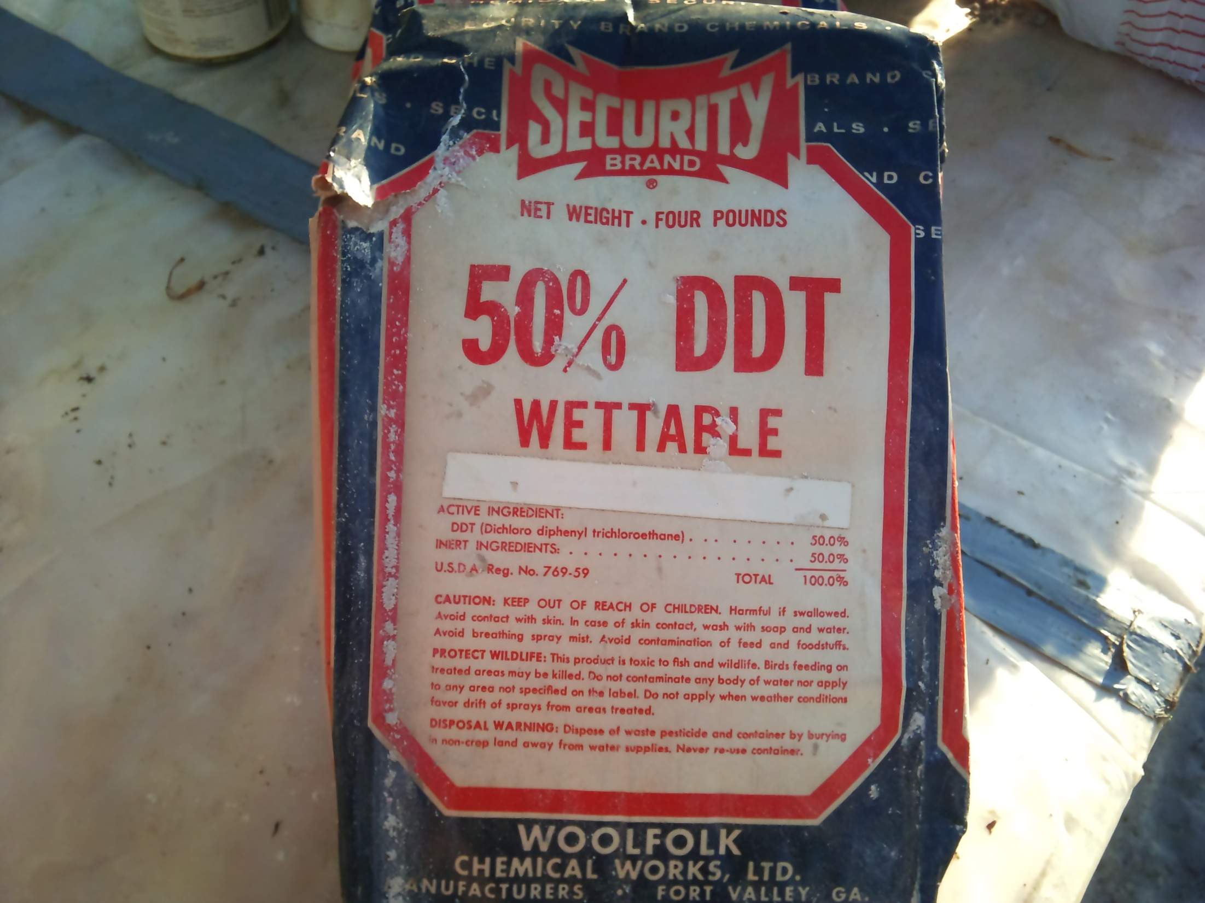

Slide 26
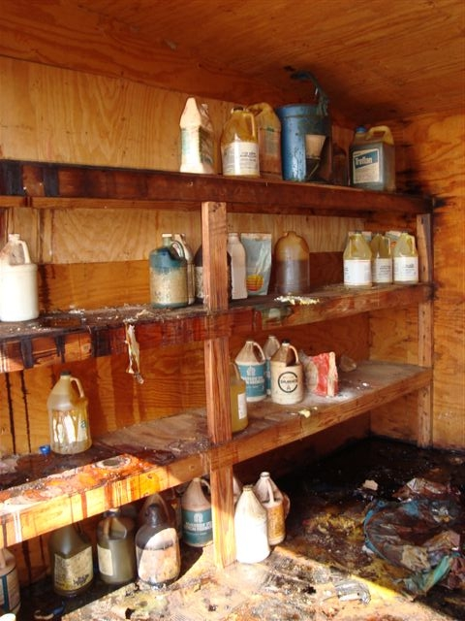

Slide 27
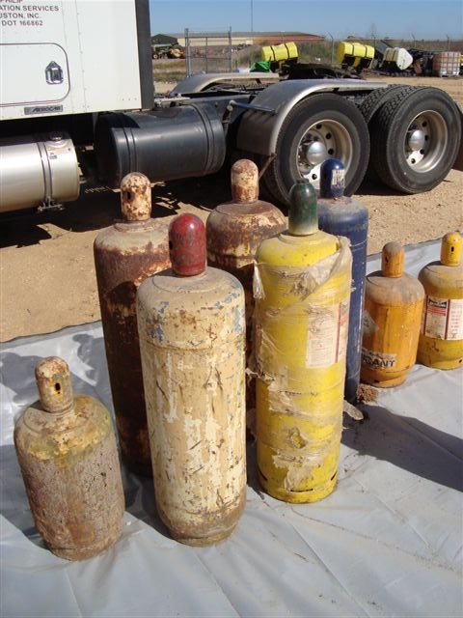
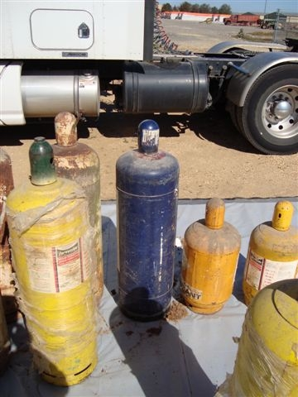

Slide 28
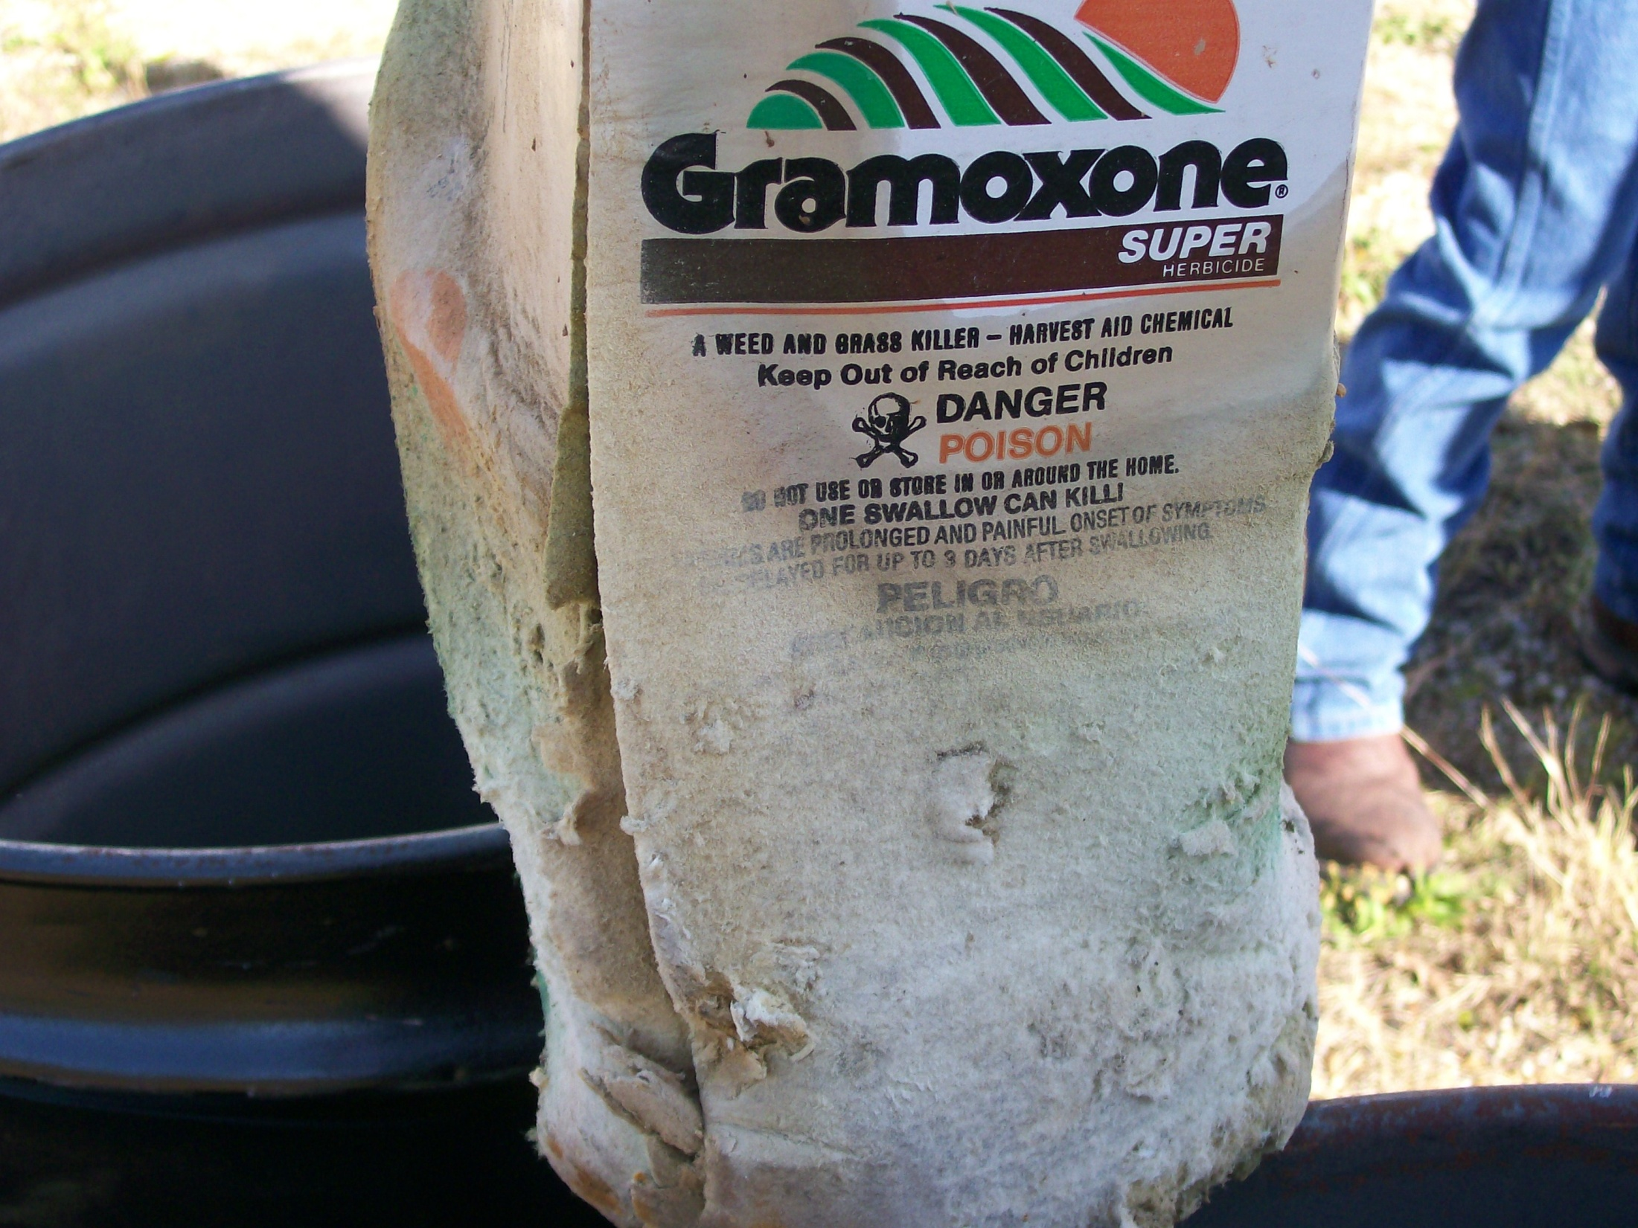

Slide 29
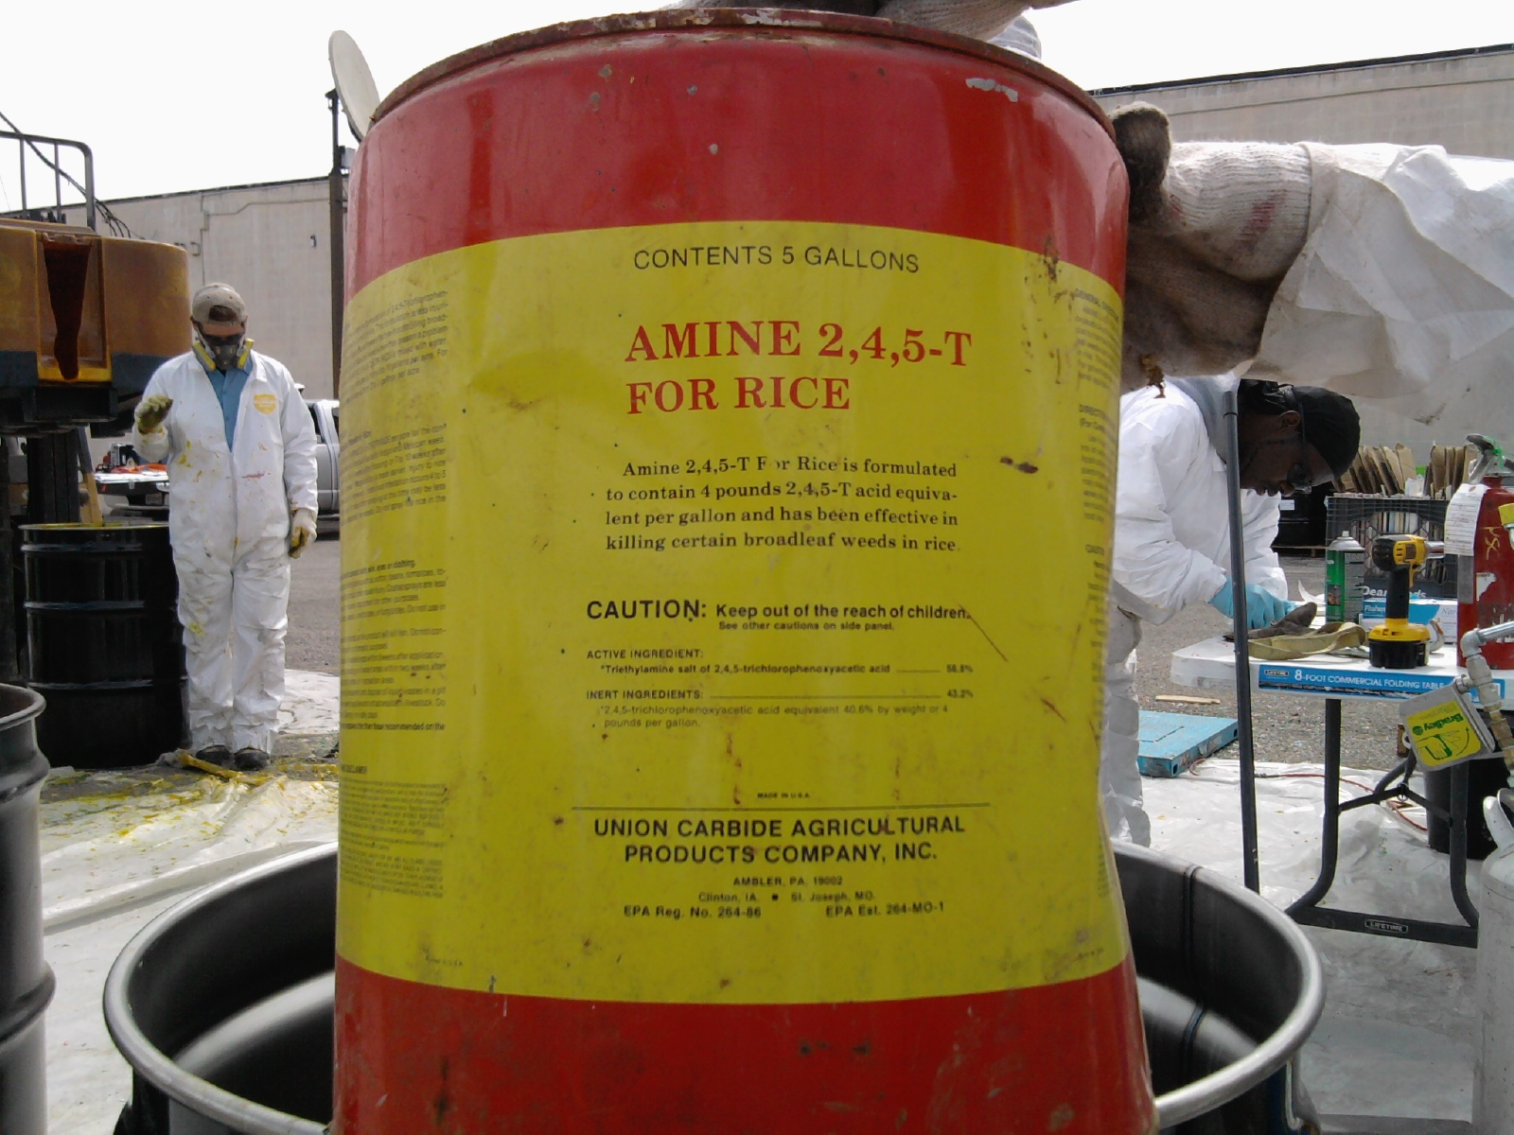

Slide 30
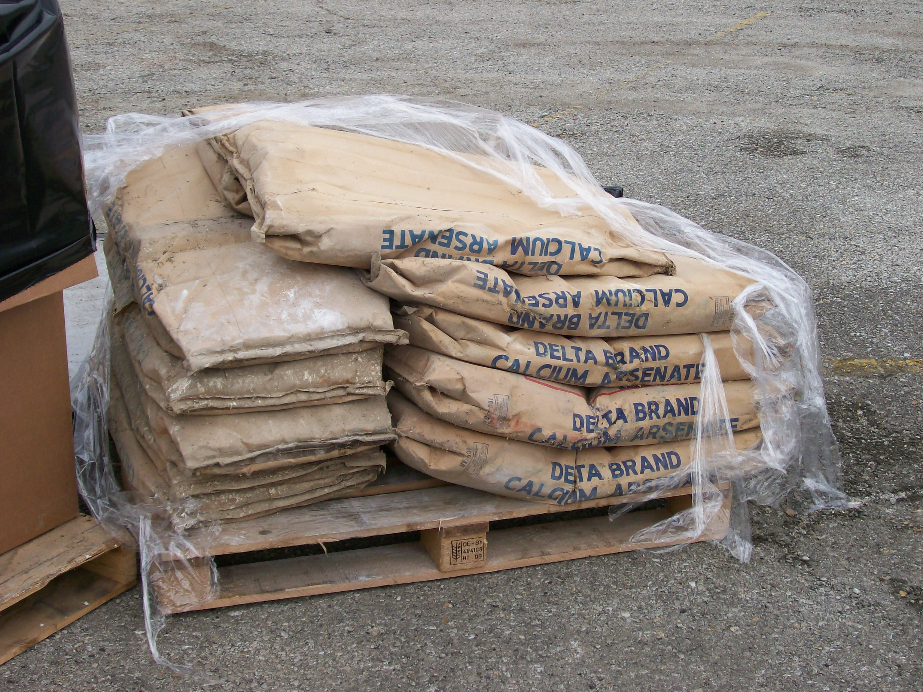

Slide 31
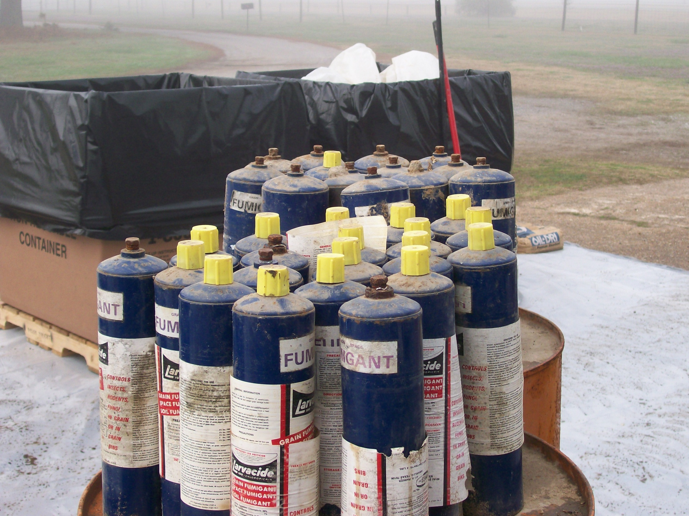

Slide 32
Program Updates
In the fall of 2012 we completed the first round of collection events for all 75 counties in Arkansas.
Since 2005 we have disposed of over 790,000 lbs. of unwanted pesticides.
We started meetings for April collections last week. We will conduct 7 collection events this spring.

Slide 33
Questions or Comments
Contact Information:
Jason Robertson
Assistant Director Pesticide Division
Arkansas State Plant Board
501-225-1598
jason.robertson@aspb.ar.gov

